Slide 1

IS MY CAR ROADWORTHY?
PRESENTED BY
TERENCE MURPHY
Murphy TSP

Slide 2
Presentation Content
Purpose
Introduction
Know your car
Preparation
Lets go through your car step by step
Tyres

Slide 3
Purpose
The purpose of this presentation is to enlighten drivers and owners on the roadworthy status of the car they are driving and own.

Slide 4
Introduction
Driving a roadworthy vehicle on a public road is a legal requirement in South Africa.
National Road Traffic Regulation 216 states that the vehicle must comply to the
South African National Standards code 10047.
Notes:
The high number of Road Accidents and their associated consequences have a significant impact on the South African society, which continues to hamper socio-economic development and impact on the well-being of all South Africans. In line with the ‘Safe System’ approach, road safety audits, appraisals and network

Slide 5
Know your car:
How many people know that each vehicle comes with an owner’s manual.
How many people have actually read the owner’s manual?
If there are any unusual noises, sound or instabilities emanating from the car you should take it to an accredited professional to have it attended to.

Slide 6
The owner’s manual is your best friend and explains
Setup instructions
Features on the car
Maintenance schedules
How to check and refill fluids
Oil change
Fuel grades
Seating positions and headrest restraints
Dashboard warning lights
How to change a wheel
Ideal tyre pressures
Warranty information
Cleaning of the car
Car safety and extending the life span of the car
Car specifications

Slide 7

Preparation
Two (2) items that you will find most useful is a comfortable pair of gloves and an old rag.
Keep these in your boot and make use of them every time you check your car.

Slide 8
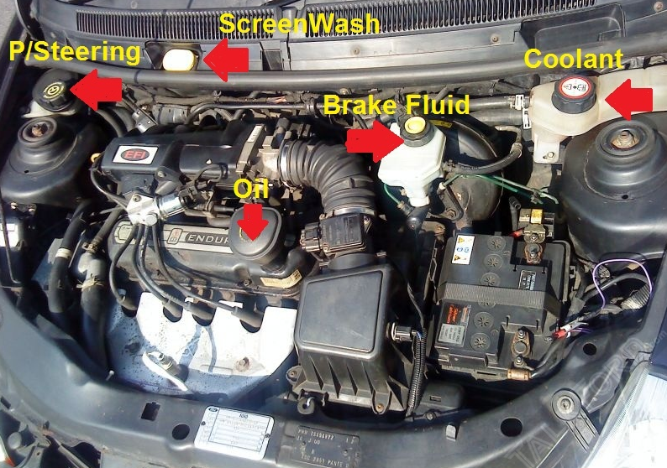
Engine Bay
Most cars today require
Petrol / Diesel to run the engine,
Oil for engine lubrication,
Oil for the power steering,
Brake fluid for the hydraulic brakes,
Water (coolant) for the radiator to control the engine temperature
Water to clean the windscreen

Slide 9
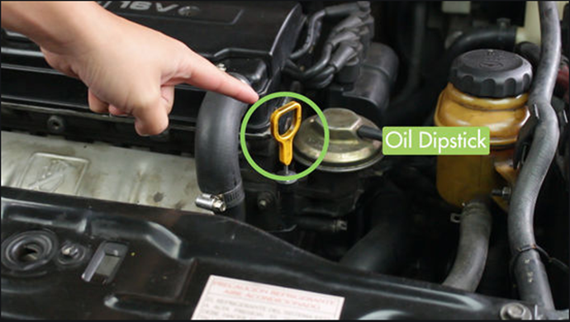
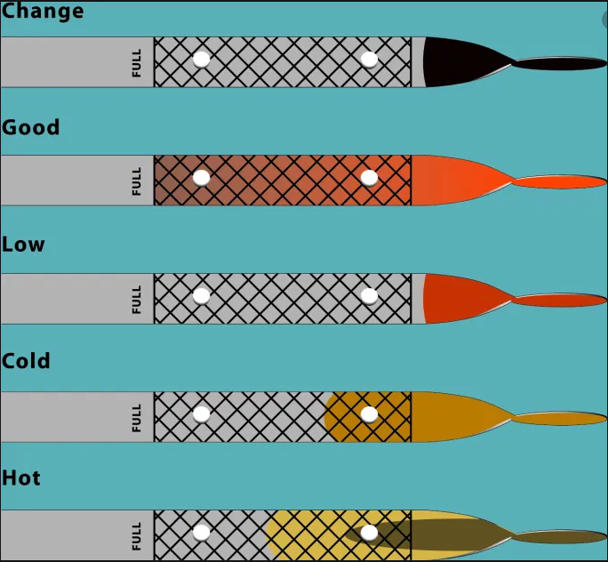
When the engine is cold check the oil by removing the oil dip stick, wipe it clean with the old rag, slide it back into the position you found it, wait (10) seconds, remove it again and note the colour and level on the end of the dip stick.
The chart below will give you an idea on the next steps to take.
Remember to put the dip stick back where you found it!
The dip stick with the yellow handle is for the engine oil and the dip stick for the automatic transmission has a red handle.

Slide 10
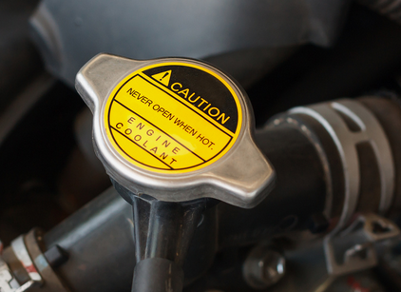
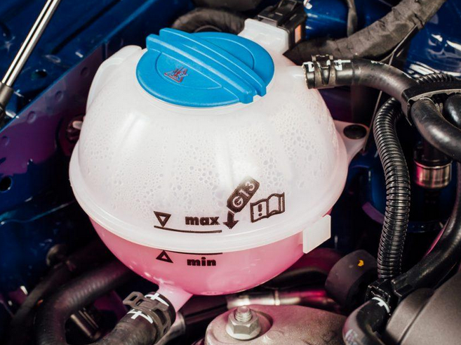
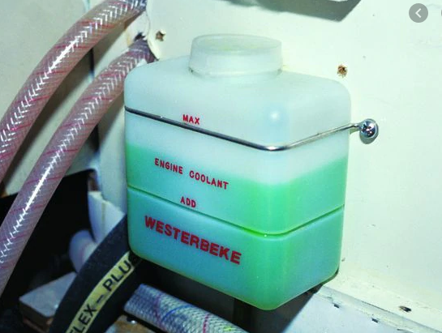
When the engine is cold check the water coolant level in relation to the marks on the side of the plastic container. Ideally it should be at the “min” marks. When hot and due to water expansion it should be at the “max” mark.
The colour of the water within container may range from red, green, or blue. This is a coolant (anti freeze) which is added to the water and prevents the inside of your engine from rusting and also prevents water freezing in extreme conditions.

Slide 11
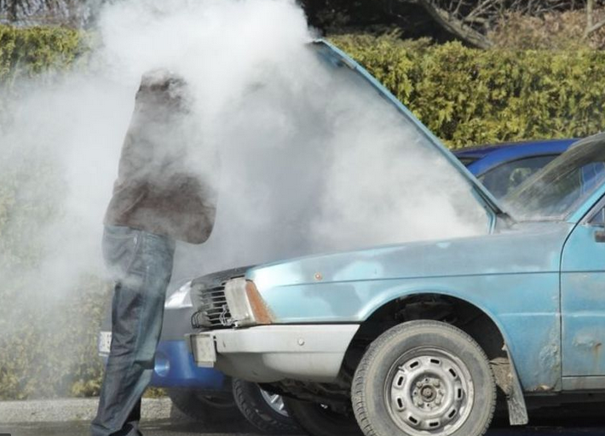
Remember to “NEVER” open a water container when the engine is hot as it generally runs at a temperature of 200° Fahrenheit (93° Celsius) and is under extreme pressure. You will get burnt.

Slide 12
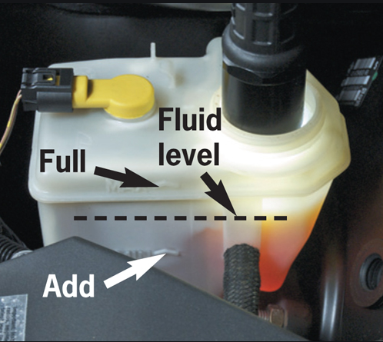
Checking the hydraulic brake fluid can be done when the engine is hot or cold it does not matter as this fluid generally remain at the ambient / outside temperature.
The brake fluid reservoir also has a see through container where marks are positioned on the side.
The fluid is a pale yellow when new and will get darker with age.

Slide 13
The engine bay must have
No leaks (oil, water, battery acid, brake fluid, radiator coolant / water) (if the battery acid has leaked it will corrode the paint work at the base of the battery, pour boiling water over it to dissolve this acid)
No strange smells (hot oil, boiling water)
No unusual banging, knocking or clunking noises
No loose wires
No loose components (with your gloves on take hold of a engine parts and move it to test that it is tight)

Slide 14
Get someone to
Start the car whilst you are standing at the engine bay (the battery must start the car easily and without any labouring)
Engage the clutch and move through the gears whilst you check the moving parts within the engine bay. (There must be no fouling or coming into contact with any other moving parts)
Turn the steering wheel from extreme left to extreme right whilst you check the moving parts within the engine bay. (There must be no fouling or coming into contact with any other moving parts)
The exhaust should not emit excessive smoke (compare this with other vehicles on the road)
In cold conditions the exhaust will emit smoke however this is vapour and you should not be alarmed.

Slide 15
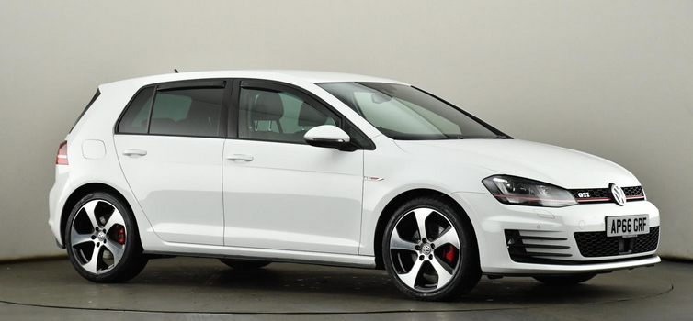
Body
All body panels must be secure. Loose panels are dangerous to pedestrians and cyclists and if they fall off whilst you are driving, can be dangerous to other motorists.
The bonnet, boot lid and all doors must be secured with their respective looking devises.
All doors must be able to be opened from the inside as well as from the outside. If there was an emergency and you were still inside the vehicle, emergency personnel must be able to gain access to you.
All door hinges and door cards (inner door panel) must be secure.

Slide 16
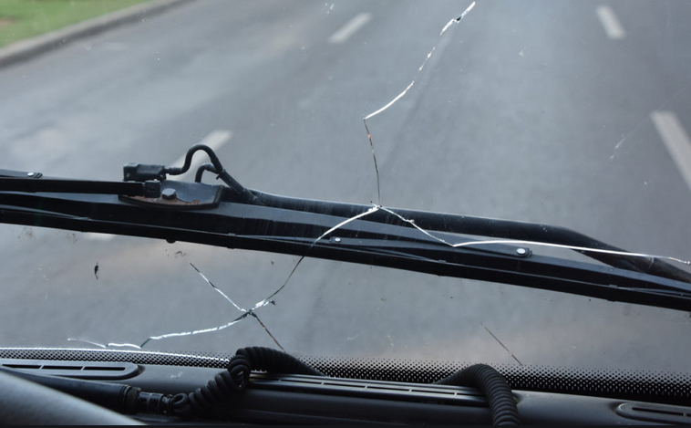
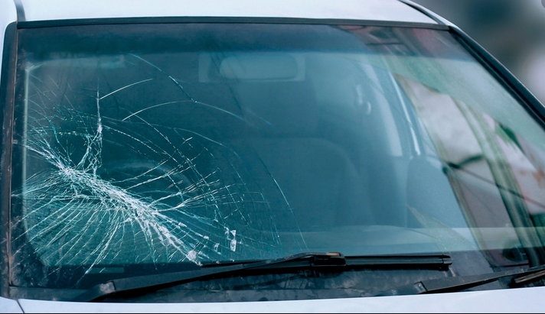
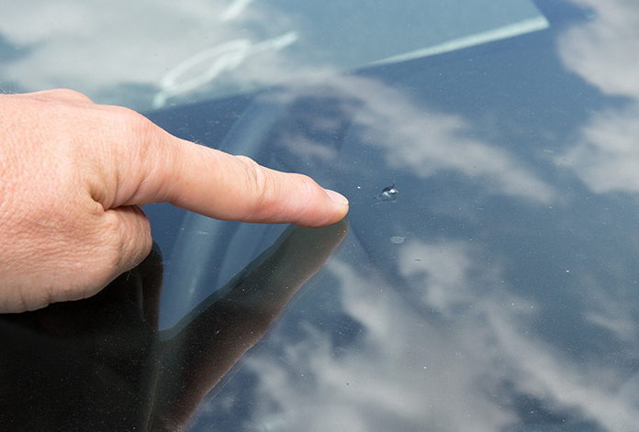
Windows
Windows must be able to be opened and closed by means of a window winder or automatically.
They must be secured within their window frames.
There must be no cracks especially within the drivers control zone (where the wiper blade runs).
If there is a chip on the windscreen have it attended to before it develops into a crack.

Slide 17
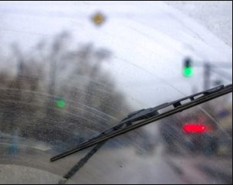
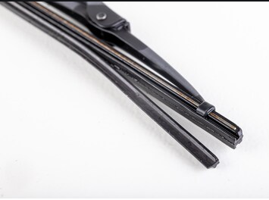
Windscreen wipers
Your car must have at least one (1) windscreen wiper (within the drivers control zone).
In areas where there is not a lot of rain (hot dry climates) the wipers are not often used and the rubber tends to become fragile and brittle.
Take the wiper blade and bend it backwards and if there are any cracks, replace the blades.

Slide 18
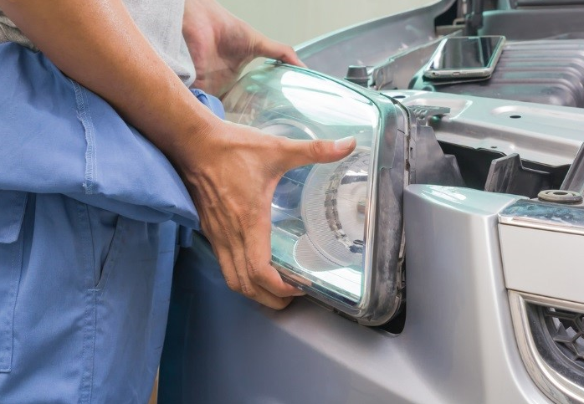
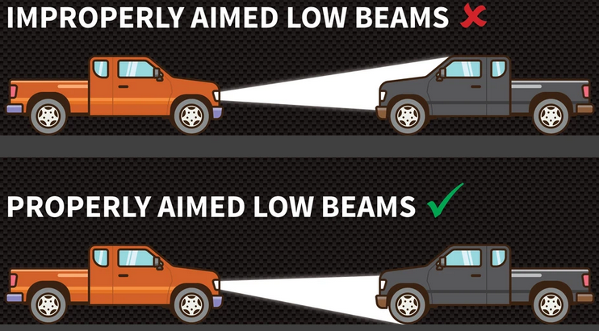
Lights and indicators
All lights fitted must be secure and not loose.
All lights must be working (headlights both low and high beams).
If you see that your light is shining up in the trees then you must have it readjusted by a competent professional as the lights will blind oncoming drivers which is extremely dangerous.

Slide 19
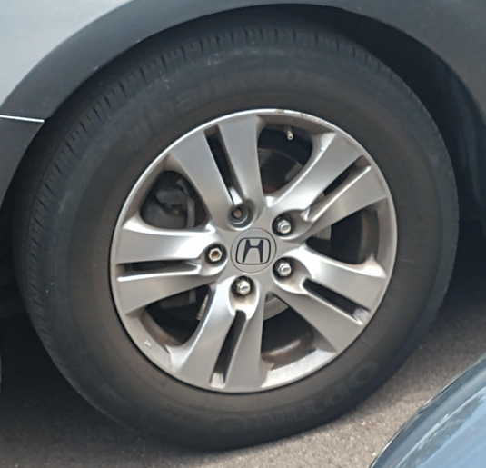
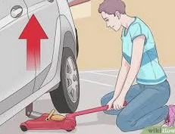
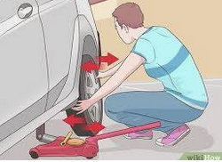
Wheels
All wheels must be securely fitted with “all” wheel nuts tight.
Your car comes with a jack and a wheel spanner the question is “do you know how to use them and change a wheel”. If not start practicing and follow the instructions in the owners manual.
If there is a rumbling or knocking sound when you drive the car it could be a wheel bearing going bad.
Put your gloves on and jack the car up. Grab hold of the wheel and move it in and out to test for any movement.

Slide 20
Brakes
Brakes are critical to your safety and should not be overlooked.
The following are abnormalities and need to be attended to:
Brakes feel spongy on foot brake application,
The car does not want to stop quickly when the foot brake is applied,
Strange grating or rumbling noise when foot brake is applied.

Slide 21
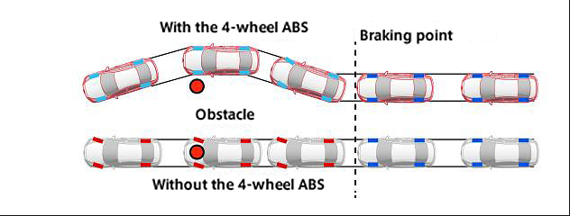
ABS (anti-lock braking system)
Most cars today are fitted with this safety feature which basically prevents your wheels from locking up under harsh braking thereby allowing you to retain your steering over the vehicle so that you can avoid obstacles.

Slide 22
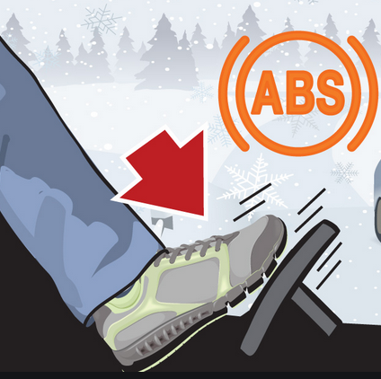
If you apply brakes harshly in an emergency you will hear an unusual rumbling noise coming from the wheels together with a slight lifting and falling of the brake pedal (pedal feedback).
This is the correct operation of this braking system fitted to your car and you should not be alarmed but continue to apply continued foot pressure and concentrate on steering the vehicle away from the danger.

Slide 23
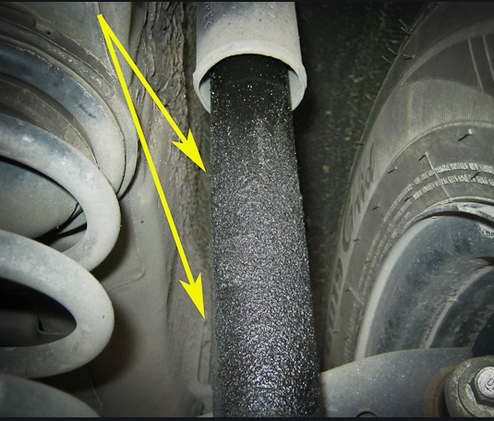
Suspension
Whilst driving over uneven surfaces or whilst cornering there should be:
No knocking, rubbing, creaking or grating noises coming from the car.
No instability in the handling of the car.
The car should negotiate the terrain and corners smoothly and if there is any instability in the car it could be a shock absorber that needs replacing because a leak has developed.

Slide 24
Interior
The inside of your car is where you need to feel safe.
Make sure that all doors can lock and all windows can close.
In hot climates it is important to have an air-conditioning system that works adequately, whether it is operated with cool air or warm air.
I say warm air because in wet and humid conditions adjusting the temperature of the air emitted will ensure that your windows do not mist up especially when there are people inside the car with you.
Make sure that your seat is secure and correctly adjusted for the best possible control over the vehicle.
Adjust the head rest so that the rear of your head is at the same level as the middle of the head rest.
Ensure that all seatbelts are functional and that you and your occupants are buckled up.

Slide 25
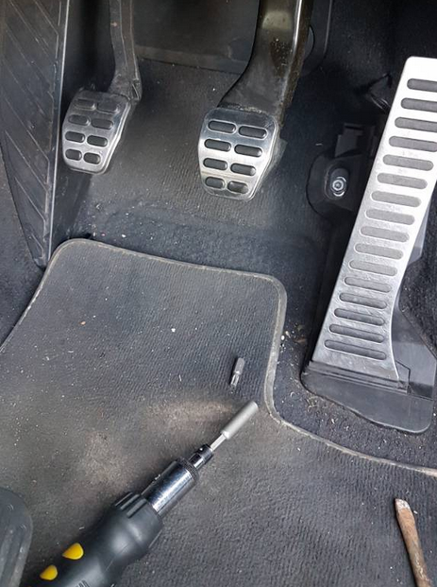
After starting the engine allow for a warm-up period of approximately ten (10) to fifteen (15) seconds before moving off.
This will allow for the lubricating fluid to circulate within the engine.
During this period ensure that all dashboard warning lights have switched off.
If there are warning lights that remain on you need to have this fault checked and rectified.
Make sure there are no loose items within the drivers foot well that can hinder you in the safe operation of the car.

Slide 26


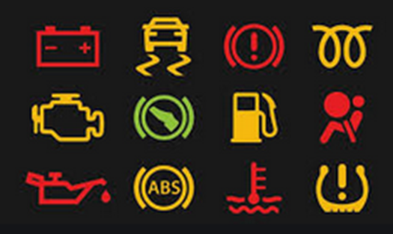

Here are some common warning light which may or may not apply to your vehicle
ESP electronic stability program fault
Brake system fault
Supplementary restraining device (air bag) system fault
Tyre pressure warning
ABS fault
Engine cooling system fault

Slide 27
When listening for strange and unusual sound whilst driving, close all windows, turn off the radio and air vents so there is silence within the car.
This will enable you to identify a sound and also it’s location so that you can explain your concerns to a certified professional to whom you take the car to for repairs.

Slide 28
Tyres
These are extremely important components on your car and often overlooked.
Your car is held off the road surface by air.
The tyre is a mere vessel which accommodates this air.
The less air (underinflation) within the tyre will result in your vehicle being unstable on the road which is dangerous.
Underinflation is the most common cause of tyre structure failure.
The correct air pressure within your tyre will result in a stable and responsive car which in turn expands the life of the tyre.

Slide 29
Tyres are extremely important because they grip the road surface
to provide traction when braking,
traction when steering or cornering, and
traction when accelerating.
Tyres also provide comfort by absorbing the bumps associated with uneven road surfaces.
Tyres are an expendable item and unfortunately need to be replaced when the need arises.

Slide 30
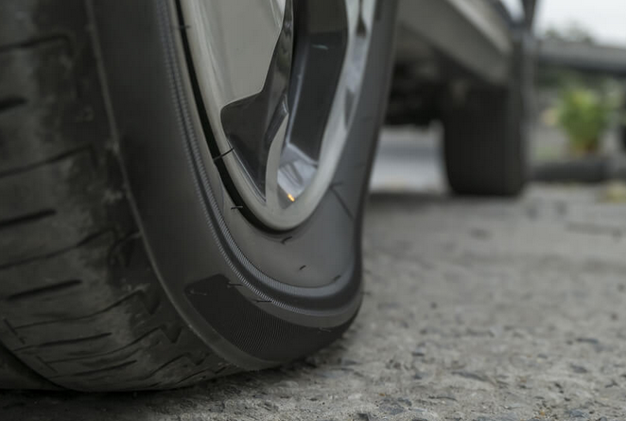
When driving the car with a tyre that is underinflated it will feel wobbly and lethargic on the road.
You will also find that if this underinflated tyre is fitted to the front wheels, the steering will be harder to turn.
You will also find that the vehicle will tend to drift and pull to the side of the underinflated tyre.

Slide 31
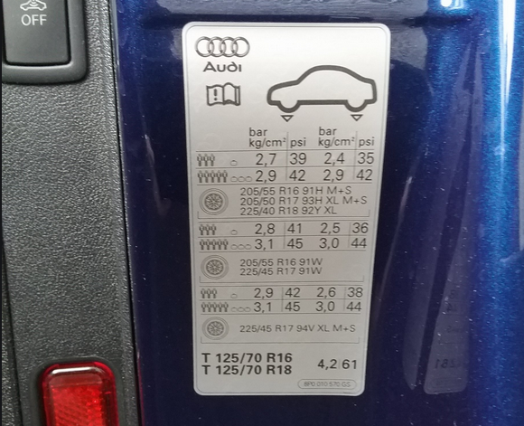
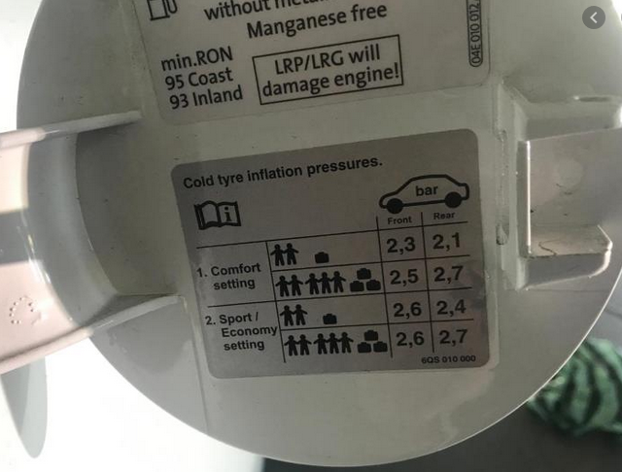
Whenever you fill petrol ask the petrol attendant to check the pressure in the tyres, it’s for free and does not cost anything.
He will ask you how much pressure you would like and if you had read you owners manual you would know.
However if you look inside the petrol flap or on the pillar of the car when you open the door you will find it.
Get out of the car and look at the tyre that has been freshly inflated and get used to what it looks like. This will help you to identify an underinflated tyre.

Slide 32
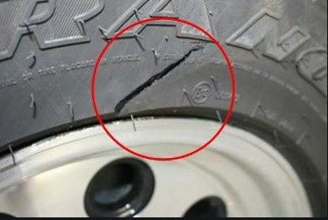
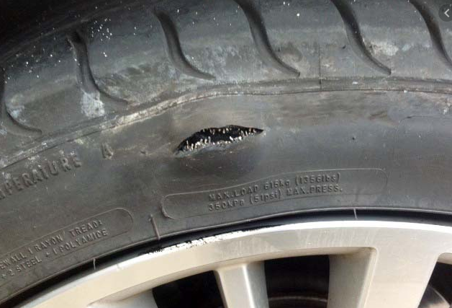
All tyre fitted at the wheels including the spare wheel (mostly overlooked) must be in good working order.
Regulation 212 of the National Road Traffic Regulations states that,
All tyre must display throughout, across its breadth and around its entire circumference, a pattern which is clearly visible, and has a tread of at least one (1) millimetre in depth,
No break in the fabric or cut exceeding 25mm or 10% of the maximum width of the tyre whichever is greater,

Slide 33
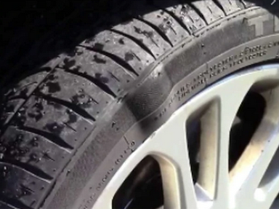
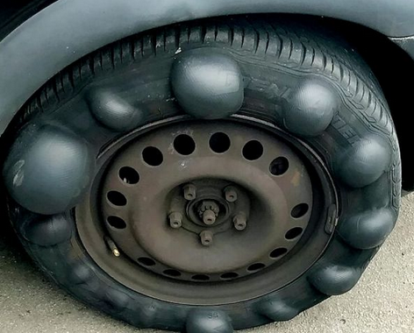
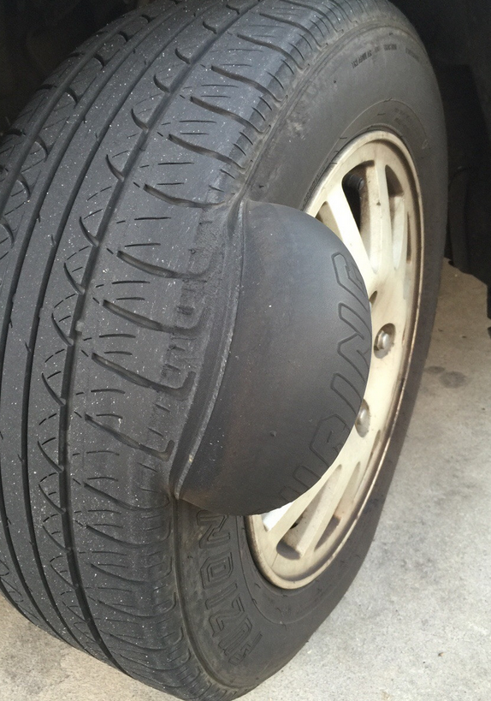
No tyre may have a lump or bulge caused by a separation of or a partial break in its structure (steel cords).
The only thing holding the air inside the tyre is the rubber hence the bulge as the steel cords have snapped.

Slide 34
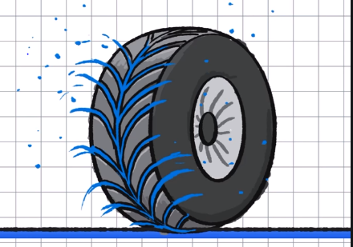
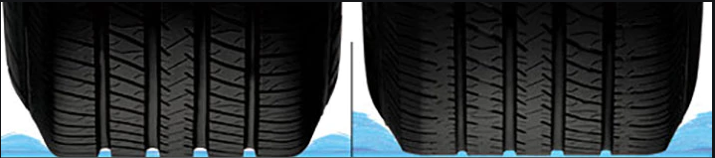
Tyre tread depth determines your car’s performance.
The tyre stands on the road surface and the part of the tyre in contact with the surface is called the contact patch which is about the size of the palm of your hand which is always in contact with the road.
The depth of the tread on the tyre is crucial in wet weather as it has a direct influence on how efficient a tyre can be at displacing water.
Full tread depth Worn tread depth

Slide 35
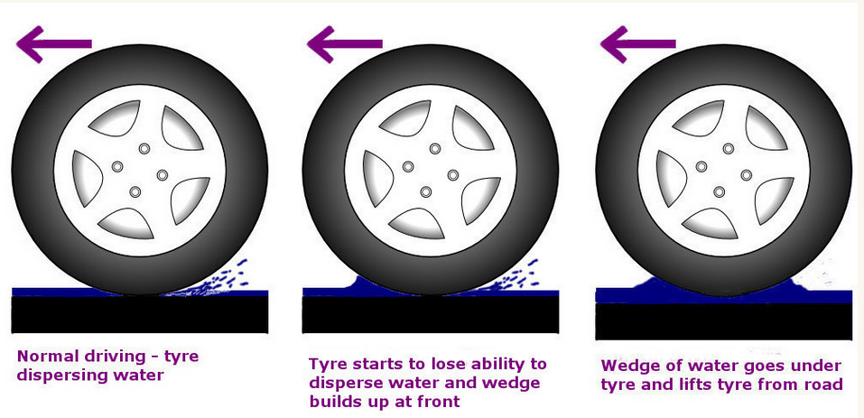
If the treads of the tyre cannot displace the water the tyre will climb on top of the water which is known as aqua planning.
At this point you will have no control over the car.

Slide 36
It is important that the same size tyre fitted to one side of the car is the same size fitted on the other side on the same axle.
Besides it being law in our country it can also be dangerous and cause your car to become unstable whilst you are driving.
It is much like wearing two (2) different styles of shoes for a day. It is not very comfortable because they will be at different heights and also have different contact patches.

Slide 37
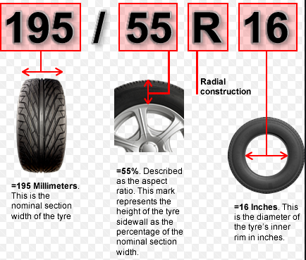
Identification of tyre information:
Tyre sizes and markings on the sidewall.
195 is the width of the tread surface in millimetres
55 is the profile (height) of the tyre (55% of the width of the tread surface)
R is the tyre construction (radial)
16 is the diameter of the tyre’s inner rim in inches.

Slide 38
Do tyres have an expiry date?
Before we get into this you will remember that I said that tyres are an expendable item and cannot last forever.
Tyres are made of a rubber compound and require oils to remain lubricated and flexible much like your skin.
Yours skin stretches and the more it is exposed to the ultraviolet rays from the sun the more is dries out and cracks. This is accentuated by the older we get.
Hence we have “tyre ageing” and terms associated with this include dry rot, sidewall cracking and tyre degradation.

Slide 39
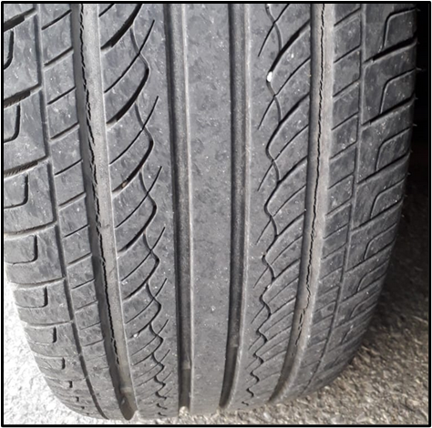
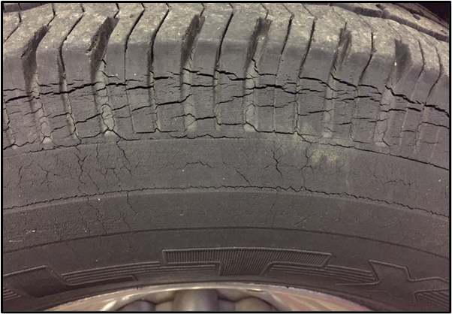
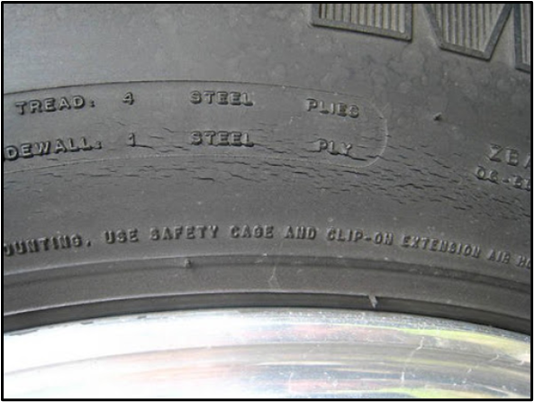
Tyre aging is also caused by high temperatures and low tyre inflation.
This is what “dry rot” looks like (cracking in the tyres below).
Tyres in this condition can be extremely dangerous as they can burst at any time if these cracks go deep enough into the tyre.

Slide 40
Do tyres have an expiry date?
In terms of South African Law the answer is no.
Tyre manufacturers however will generally give you a five (5) year guarantee / warrantee on the tyre that you bought.
This period starts from the time that the tyre was manufactured.
So how old are your tyres?
By law and besides the tyre sizes on the sidewall of the tyre there must also be a manufacturing date.

Slide 41
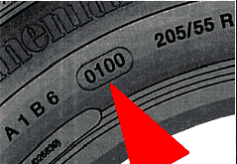
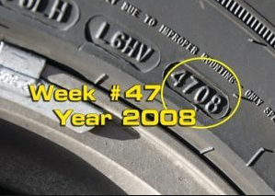
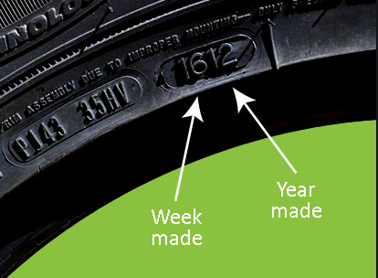
There will always be four (4) numbers embossed on the tyres sidewall.
0100
01 week of the year 2000
4708
47th week of the year 2008
1612
16th week of the year 2012

Slide 42
When you go to the shop to buy bread and milk you go to the shelf and look at the sell by date.
You scratch at the back of the shelf because that is where the shelf packers have placed the items with the longest sell by dates.
I can see you all nodding your heads because you want the best deal.
Why then do you not demand “fresh” tyres when you embark on an expensive tyre purchase.
Check the manufacturing date on the tyres that you are purchasing and although you can see that the tyre is brand new and they tell you that it is brand new, you are not buying fresh tyres and you are loosing out on the guarantee / warrantee period.
The fact that the tyre has been sitting on their shelf for a long time is not your problem.

Slide 43

Please be safe on the road and buckle up
Terencem@rtmc.co.za

