Slide 1

IMPAIRED AND DISTRACTED DRIVING
PRESENTED BY
PENELOPE SHIBAMBO

Slide 2
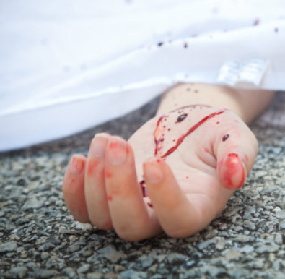

My duty today is to show you the realities I am faced with everyday as a Crash Investigator…..

Slide 3
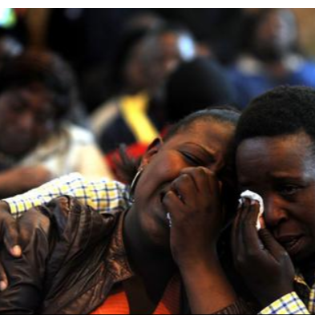
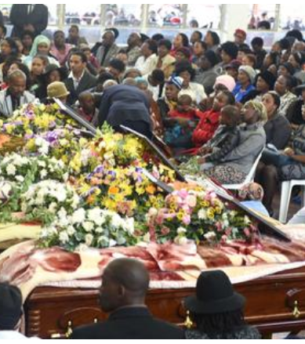
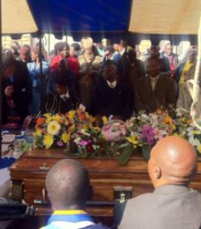
We are accountable in providing answers to people who have lost their loved ones in a crash.

Slide 4
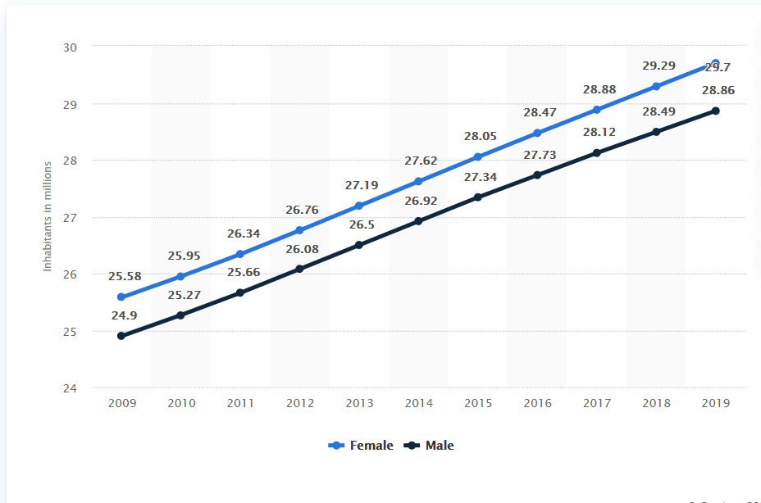
There are 59,62 million people in South Africa and more than half of the population is female.
Throughout the years women’s role changed as more women entered into the economy.
This necessitated the need for women to own a car and obtain a driver’s license.
There are 14,9 million South Africans of working age that drive themselves to their workplaces and 23% of those are female.
Notes:
1- Statssa and News24

Slide 5
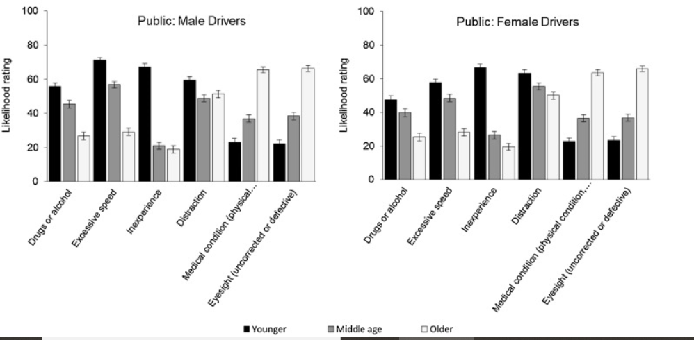
Statistics from Alexander Forbes Insurance show that men have fewer crashes than women.
However, the extent of the damage done to vehicles is more severe.
Men are more likely to write off a vehicle than women.
Statistics also show, from middle age, there is a higher crash frequency for female drivers. This is attributed to distracted driving. As shown in the graph women have a higher rate of distracted driving as compared to their male counterpart.
Notes:
Table insert

Slide 6
Distracted driving is driving while doing something else, typically driving with children in the car.
There are four types of distractions while driving
Visual – looking at something other than the road.
Auditory – hearing something not related to driving.
Manual – manipulating something other than the steering wheel.
Cognitive – thinking about something other than driving.
Distractions put extra demands on the driver, which may reduce her driving capabilities and increases the risk of being involved in a crash.
Crash Involvement = Risk + Prevalence- the more you are involved in risky behaviour, the higher the chances of being involved in a crash.
All distractions endanger the all road users.

Slide 7
The most alarming of these distractions is the one that requires the driver to take her visual, manual and cognitive attention away from driving such as texting.
The average driver takes her eyes off the road for 5 seconds at a time while texting. At 60km/h, that is like driving blind for almost the length of a soccer field.
Lets look at the following video on distracted driving and how it affects your driving capabilities.

Slide 8
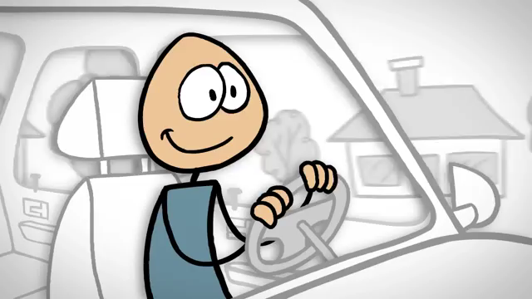

Slide 9
Simple test.
Next time you have a conversation on your cellular telephone, after ending the call try to recall what you’ve seen, you’ll realise you don’t remember much of what happened during your call.
Cellular telephone conversations decreases the brain’s ability to process moving images, even when the driver’s eyes are on the road, they overlook a lot around them.
While it is legal in South Africa to use a cellular telephone for verbal communication, that does not mean using hands free device while driving is safe.
The best you can do is not to use your cellular telephone when you’re behind the wheel.

Slide 10
What are some of the reasons people text and drive……
In 2008, Jacy Good was involved in a crash where her parents were killed coming home from her college graduation.
The crash was caused by a distracted driver on his cellular telephone that caused a truck to swerve in front of Jacy’s family car.
Is a text so important that it cannot wait?
You decide for yourself….

Slide 11
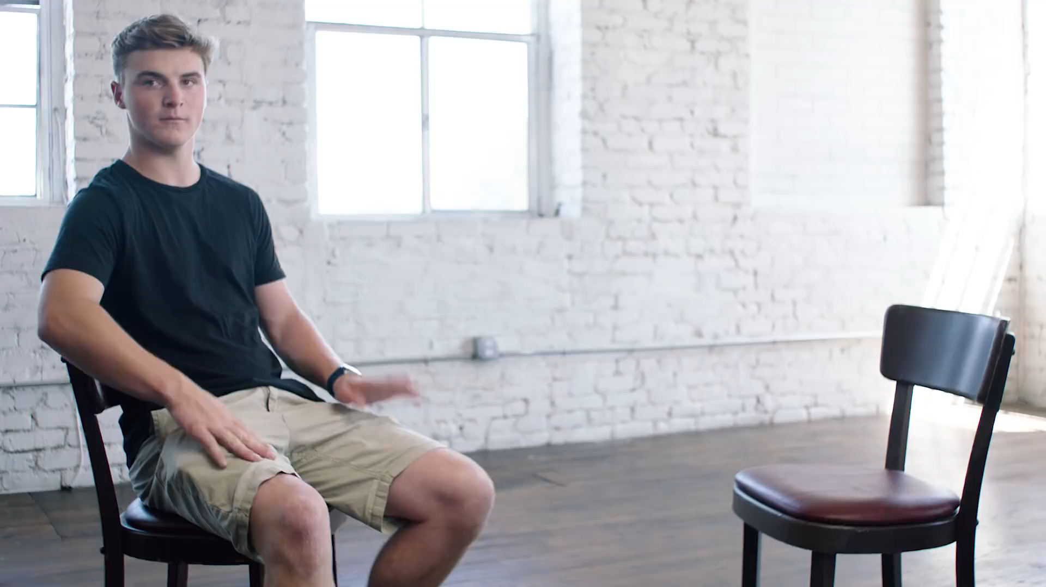

Slide 12

Those little precious humans of ours that we love so dearly can also be distracting and can contribute to the cause of some crashes.
I am sure most of us can related to this video.

Slide 13

Ladies, this is fact multi-tasking is a myth.
I know it’s hard to except because we believe we can multi task but the brain cannot focus on more than one cognitively demanding task at a time.
My word of advice to you ladies is concentrate on the task at hand in order to stay safe on the roads. Let’s look at the video that shows you that multitasking while driving is a danger to you and other road users.

Slide 14
The types of driver distractions posing a risk to road safety
Physical distractions
Physical distractions are actions the driver might perform, actions by his passengers or technology in the car – and also distractions outside the vehicle that could divert the attention of the driver away from safely driving the vehicle.

Slide 15
Physical distractions include:
Roadside activities such as accidents or vehicles stopped by police/ traffic officers
Looking around at outdoor advertising or construction sites
Reading maps or newspapers
Personal grooming such as applying lipstick or mascara, combing or brushing your hair
Eating or drinking and
Changing clothing

Slide 16
Physical distractions:
Looking for lost or fallen items
Flying insects in the vehicle
Talking on cellular telephones
Tuning the radio, tape or CD players can also be distracting
Conversing with adult passengers
Tending to small children and infants
Even smoking

Slide 17
Mental and emotional distractions
Mental and emotional distractions may cause a driver to be more aggressive and less tolerant of other drivers. She might also become less attentive towards environmental conditions and hazards on the road.
Mental and emotional distractions are:
Strong emotions of anger and grief
Driver tiredness/ drowsiness
Arguments and emotional conversations may lead to further distracting your attention

Slide 18
Distractions caused by cellular phones and technology
There is a growing concern about the dangers posed by motorists using cellular phones whilst driving. The best advice is to avoid using cellular phones when driving
When the phone rings, let it ring! It’s better to use your phone’s voicemail or even miss a call than to put yourself, your passengers or others at risk.
Use hand free microphones
If you have to make a call on a hands-free cellular phone – ask a passenger to dial or answer the phone for you
Keep your calls brief
If you expect such a call to last longer than a few seconds – be on the lookout for a suitable spot to pull over
Never take notes or jot down numbers whilst driving
When in heavy traffic –rather tell the person you will call back when it is safer

Slide 19
Impaired Driving
Impaired driving is dangerous, because you are driving while you are affected by alcohol, legal or illegal drugs, sleepiness and having a medical condition which affects your driving.
Driving while under the influence of alcohol or drugs is similar to distracted driving because the driver’s visual, manual and cognitive skills decrease due to intoxicant.
You might think that you are “fine to drive” after a cocktail or two or taking a nap after drinking, but you’re not. A short nap does not make you legally sober because your body hasn’t had a chance to process out the alcohol, it takes about an hour for each drink you've had to process out the alcohol in your system meaning alcohol is still in your blood stream and your judgement is still impaired.
Major dangers of drinking and driving include, slow reaction time, lack of coordination, less concentration, inadequate judgement and impaired vision (seeing double). These can lead to serious and extreme consequences such as severe injury or death as well as have legal ramifications.

Slide 20
What can you do to avoid distracted and or impaired driving:
Stay focused and alert at all times
Practise short quick glances and avoid prolonged staring
Never read whilst driving – rather pull off the road to read
Do not attempt to change or pull off clothing while driving
Conduct personal grooming before leaving or after reaching your destination
Do not allow passengers to interfere with your concentration
Make sure children and pets are properly restrained before you start driving – and give children items to occupy themselves

Slide 21
What can you do to avoid distracted and or impaired driving:
Use pet carriers or portable kennels to restrict the ability of animals to roam around in the vehicle.
Pull over and stop if small children require attention that could divert your concentration from the road
Avoid eating and drinking while driving - fumbling with napkins, wrappers and beverages means you’re not watching the road.
Plan your trip in advance and allow yourself time to stop and have a bite to eat

Slide 22
The End

